Slide 1
PSDL-II
MINI PROJECT
PRESENTATION

Slide 2
Group Members Details:
2. Problem Statement :
3461 - Bhaktee Ugale (C22020221461)
3472 - Yashvi Bhutada (C22020221473)
3479 - Tejal Wakchaure (C22021222405)
Fitness Application

Slide 3
3. Technologies Selected and Used :
Technology Used : Android
IDE Used : Android Studio
Programming Language Used : Java
Database Used : SQLite DB

Slide 4
4. Details of Project :
We have Developed Android App through Android Technologies which provide User with Fitness Workouts with Effective Exercises.

Slide 5
5. Module with Scope :
FrontEnd Module :
Includes all the Frontend Libraries, Activities we have done in our Fitness Application.
Interact with the Model Module to get access to the database.
Model Class Module :
Includes all the data and attributes frontend activities want to access.
Interact with another class to get DB access.
Database Module :
Contains the Actual Database Created for the Fitness Application.
DatabaseHelper Class Module :
Interact with the Database and implement the Sqlite DB
Created a Database , Tables its attributes inside this Module
We have divided our Project into 4 modules:

Slide 6
6. Sample Code
public class FBExe1 extends AppCompatActivity implements View.OnClickListener {
private CountDownTimer mCountDownTimer;
private boolean mTimerRunning;
public void onCreate(Bundle savedInstanceState) {
super.onCreate(savedInstanceState);
setContentView(R.layout.fbexe1);
if (getSupportActionBar() != null) {
getSupportActionBar().hide(); }
public void onClick(View v) {
if (mTimerRunning) {
pauseTimer();
} Glide.with(this).load("https://www.spotebi.com/wp-content/uploads/2014/10/push-up-exercise-illustration.gif").into(imageView);
updateCountDownText();
}
}

Slide 7
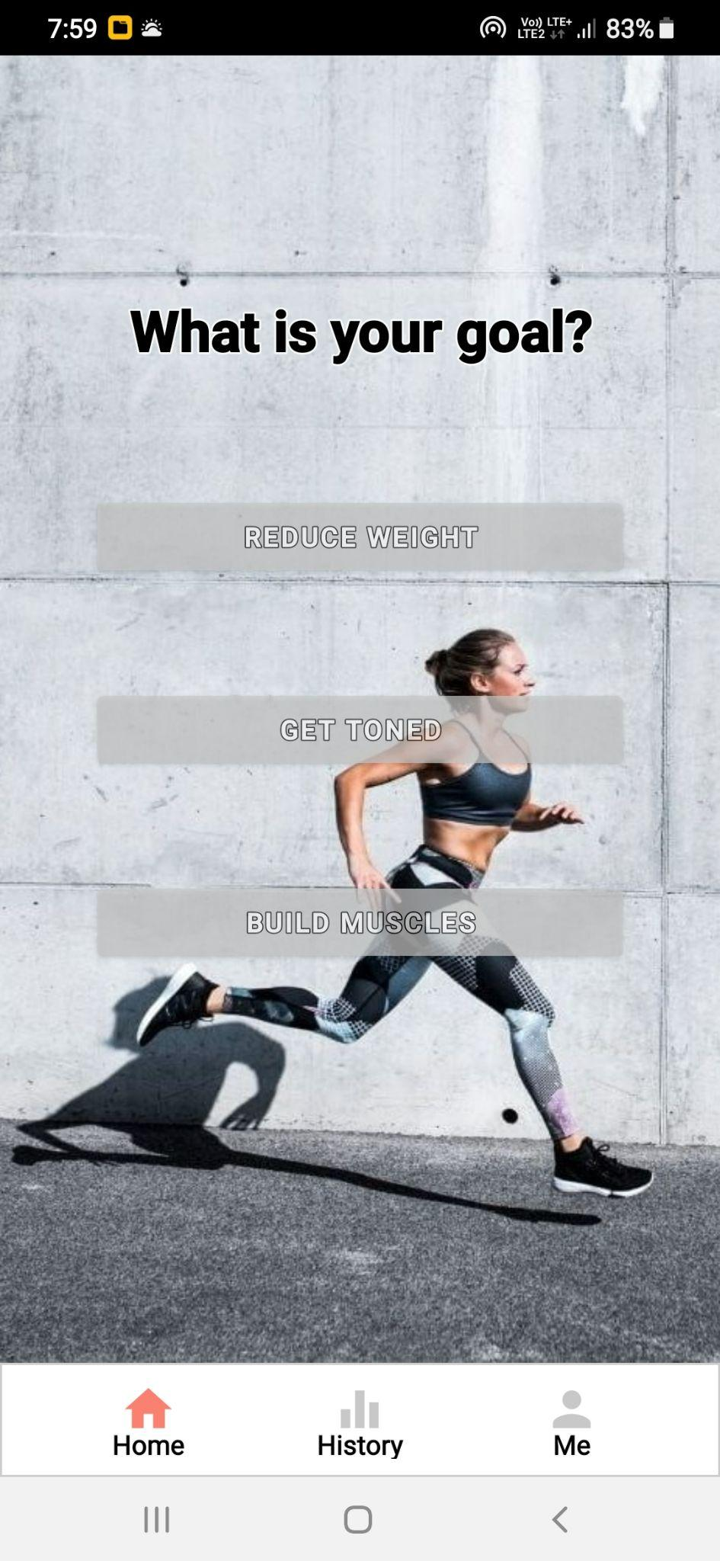
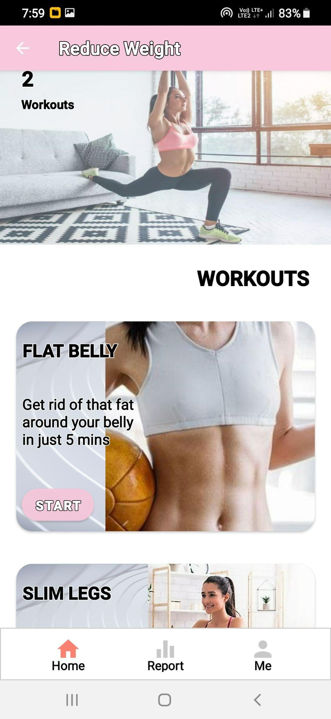
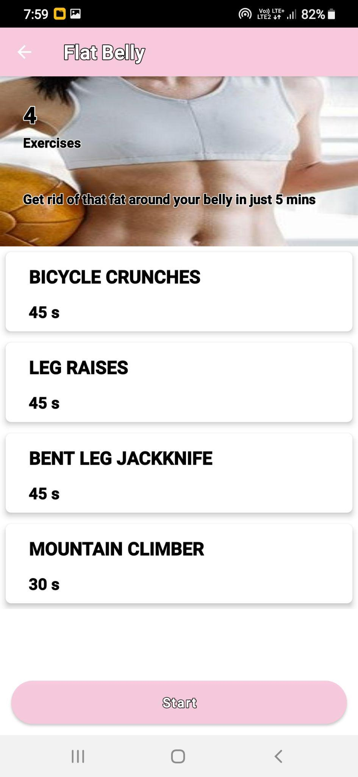
7. Outputs of the App :
Home Screen
Reduce Weight Workouts
Exercises

Slide 8
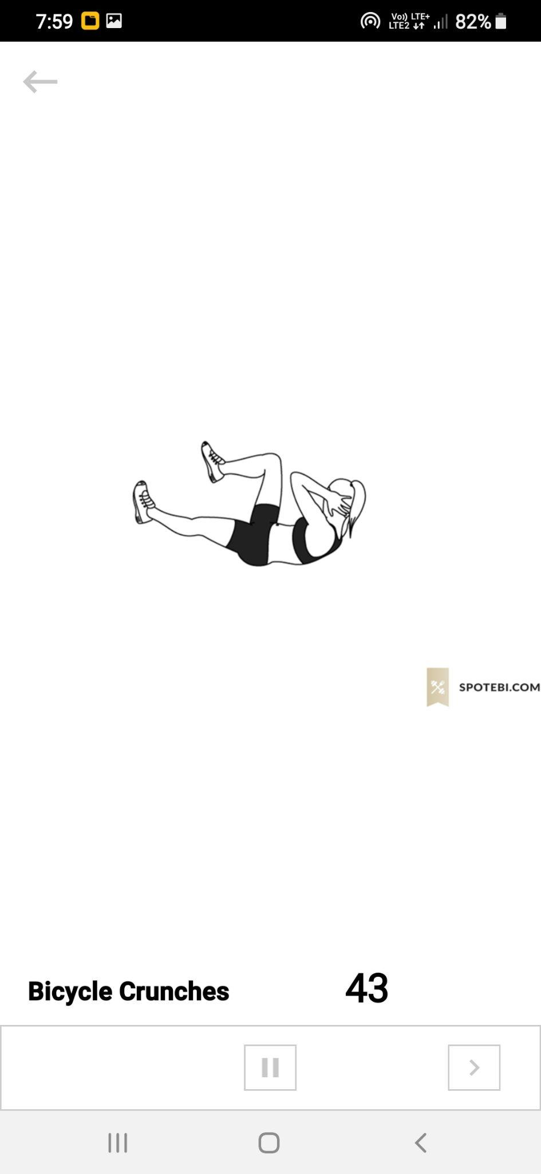
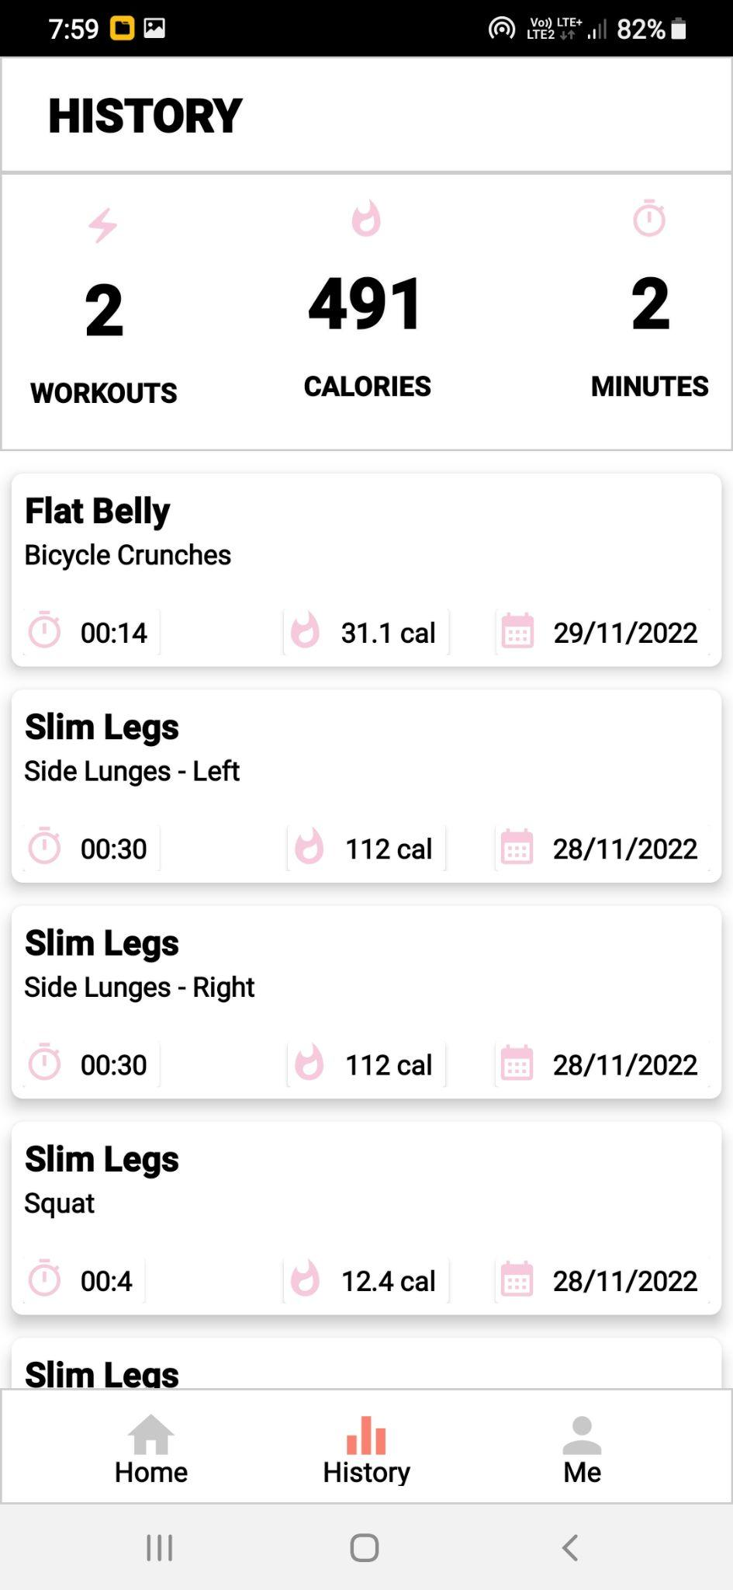
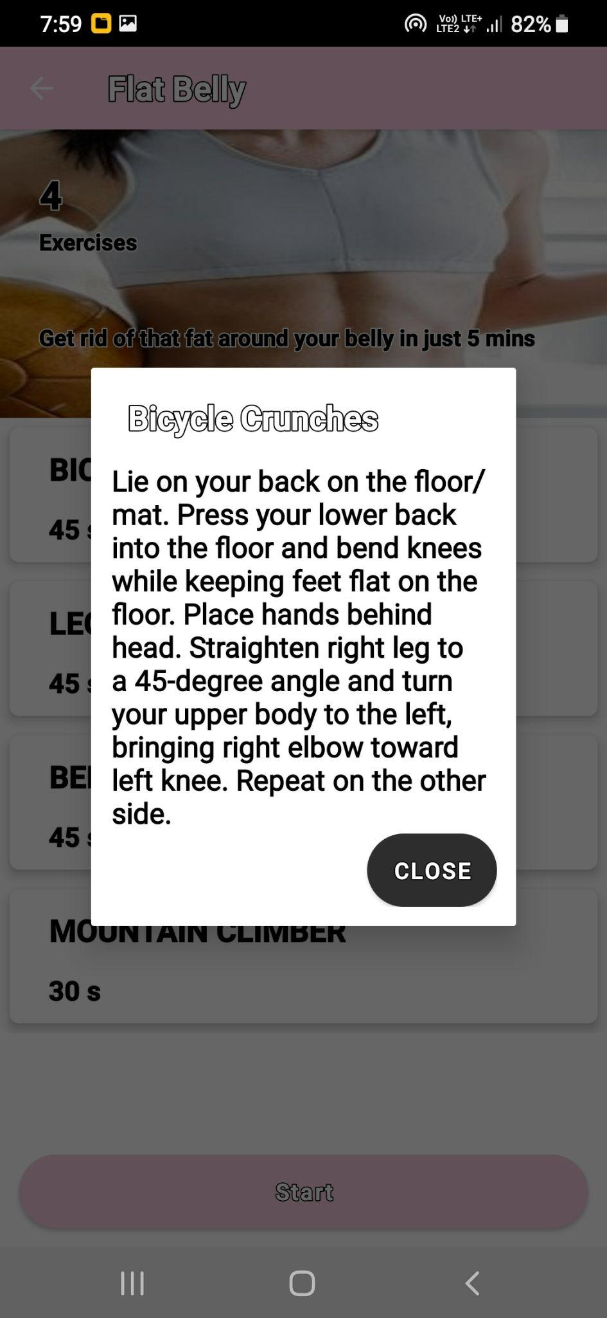
Start Exercise
Workouts Done
Info of Exercises

Slide 9
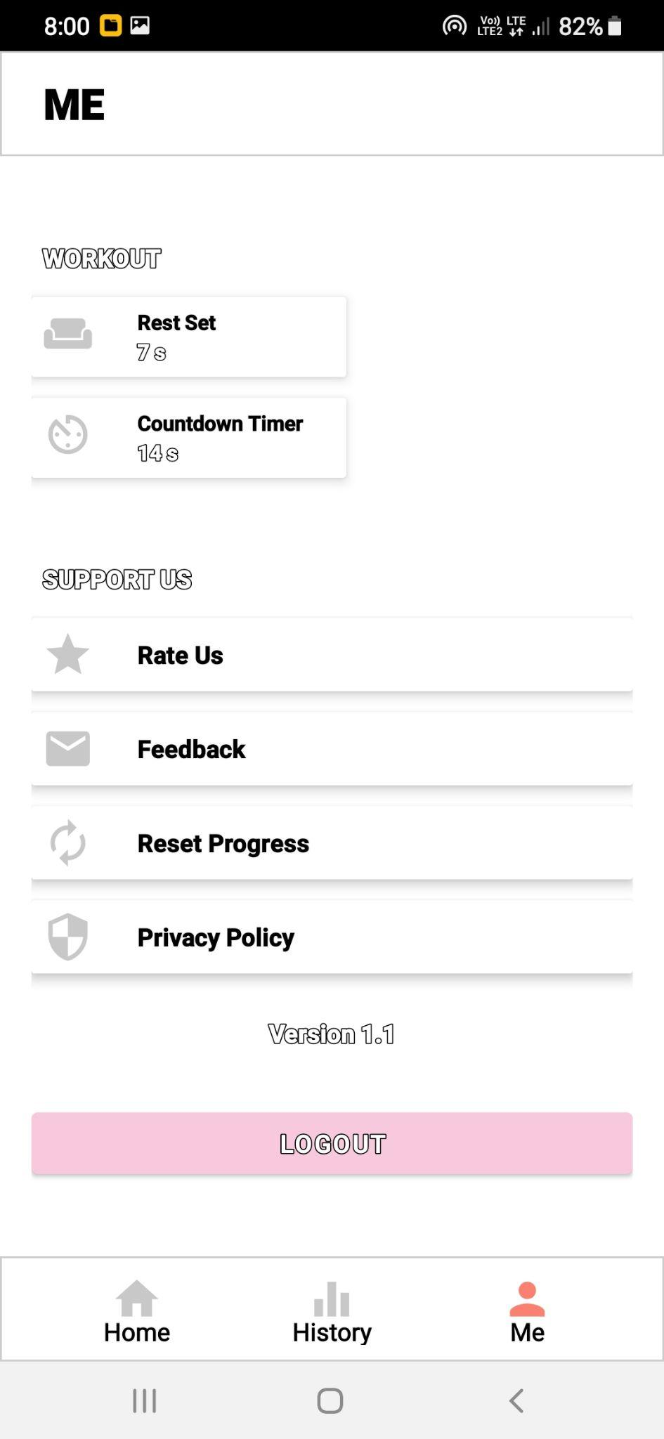
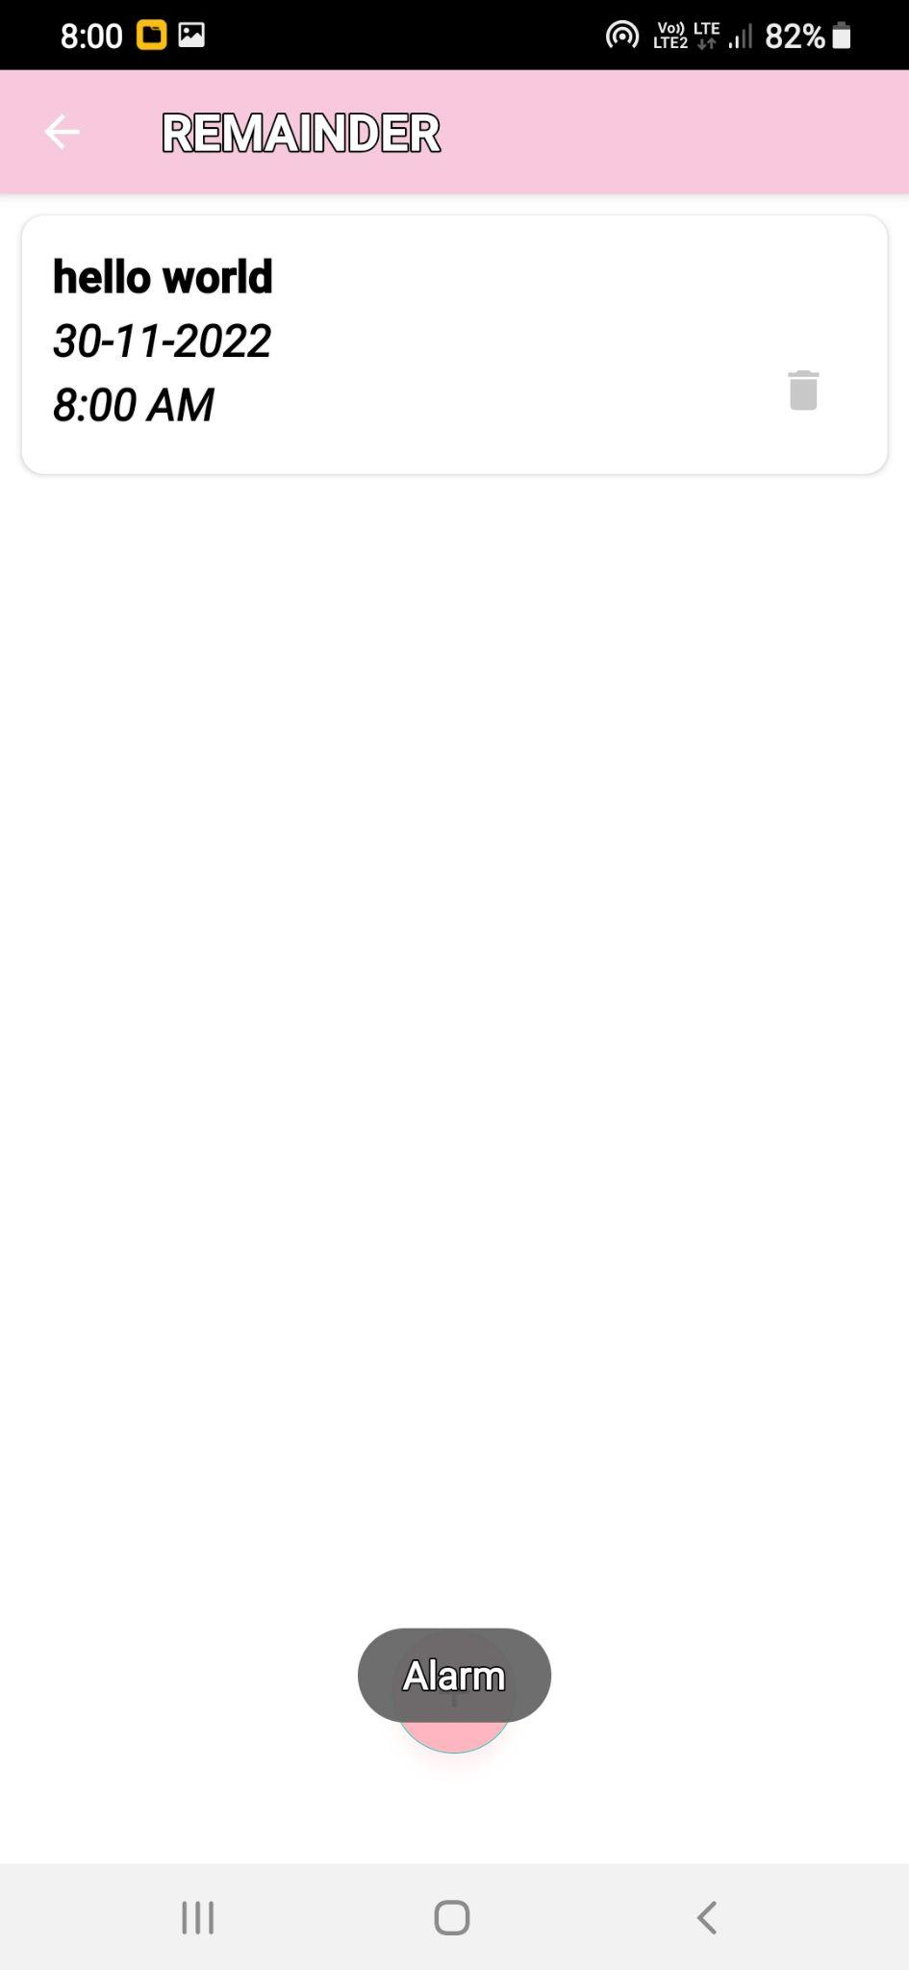
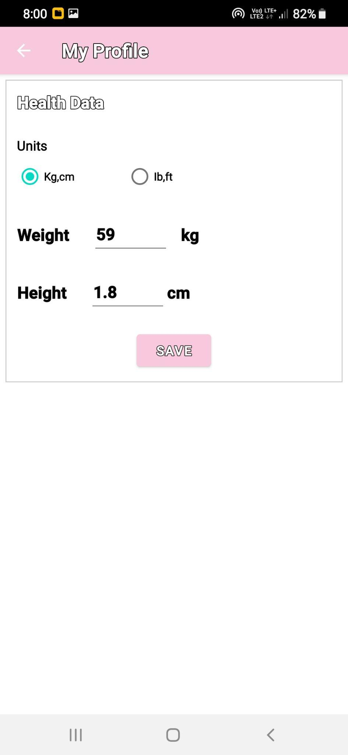
My Profile
Reminder
Health Data

Slide 10
8. Conclusion :
We have Developed a Fitness Application by using Android Technologies.

Slide 11
8. References :
https://developer.android.com/studio
https://abhiandroid.com/

Slide 12
THANK YOU

